Slide 1
Module 5 Linux and App Service
Jim Cheshire, Sr. Escalation Engineer, App Service Serviceability

Slide 2

Most Important Point of All
SPEED
LIMIT
70

Slide 3
Hosting Web Apps on Linux
App Service on Linux and Web App for Containers.
Not all App Service features are available on Linux.
Features that aren’t available are grayed out in the portal.

Slide 4
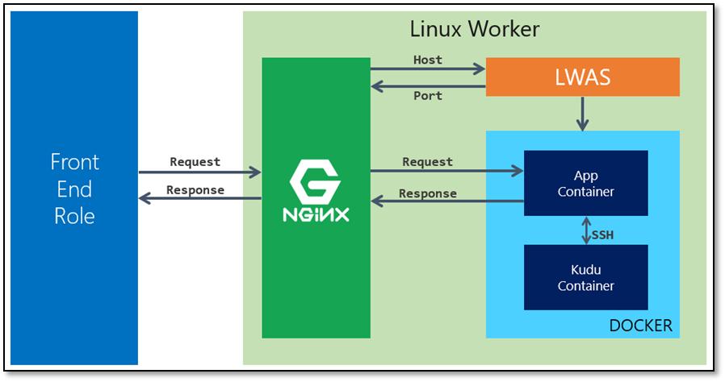
Architecture
Notes:
Items to point out:
We use Nginx as a proxy. This should be invisible to the customer.
The LWAS is like DWAS in a Windows stamp.
LWAS stops and starts containers.
LWAS mounts storage as a CIFS mount. (Optional in WAfC.)

Slide 5
App Service on Linux
Docker images are maintained by Microsoft.
In Docker Hub at https://hub.docker.com/u/appsvc.
Source repository for each image available in GitHub.
Images internally referred to as blessed images.
We currently support:
Node.js
Java
PHP
.NET Core
Ruby
Apache Tomcat
Notes:
I recommend you browse to Docker Hub here and show where images are in GitHub as well.

Slide 6
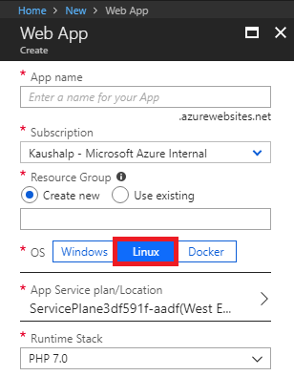
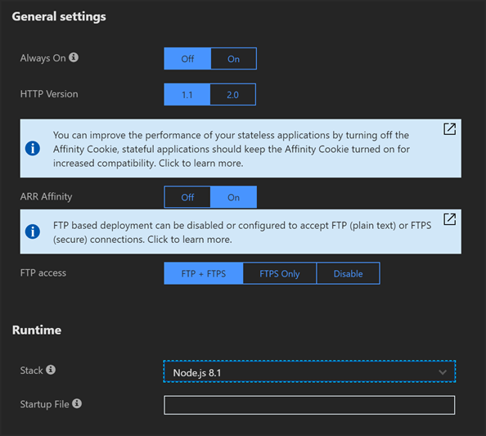
App Service on Linux (continued)
Startup File is for:
Specifying PM2 config file or script file for Node.js apps.
Specifying compiled DLL file for .NET Core apps. (dotnet <myapp>.dll)
Specifying the Ruby script to initialize Rails apps.
Notes:
Explain here that you’re choosing “Linux” as the OS and you select a Runtime Stack. You can change stack later in App Settings.

Slide 7
Web App for Containers
Use custom containers from a Docker registry.
Suitable solution if our blessed images don’t fit your needs.
Can’t host all Docker containers.
Container must be designed to listen for HTTP requests and send HTTP responses.
Container can only expose one port.
Notes:
Mention here that running containers on Windows is in preview, but this training doesn’t cover that.
Point out that “web job” types of containers won’t work.
Point out that web-based containers that use a separate port for admin interface won’t work.

Slide 8
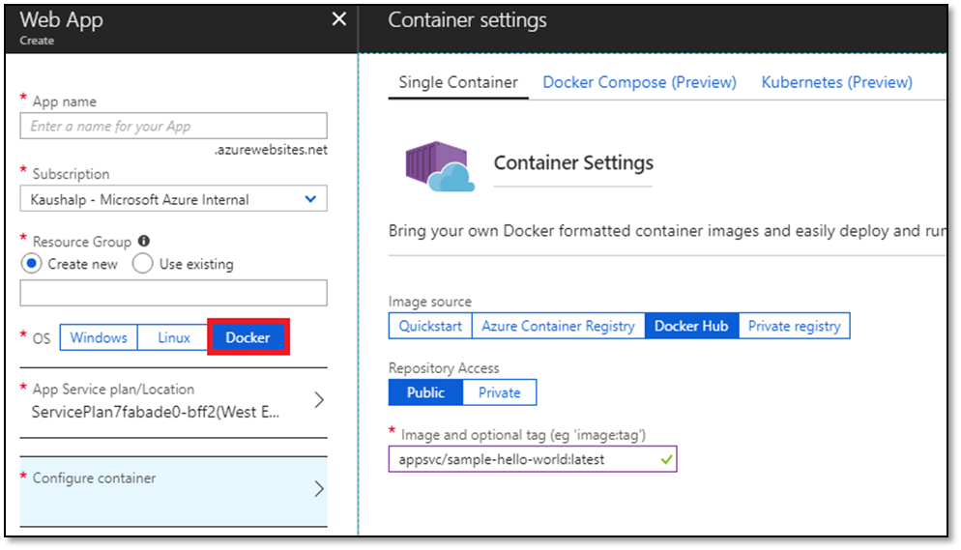
Web App for Containers (continued)
Notes:
Walk through this interface. Point out that you have to specify an image name and you can optionally add a tag. Also show the multi-container stuff briefly and mention that it’s covered in detail later in the module.

Slide 9
App Settings for Linux
WEBSITES_ENABLE_APP_SERVICE_STORAGE (WAfC Only)
WEBSITES_WEBDEPLOY_USE_SCM
WEBSITES_CONTAINER_START_TIME_LIMIT (WAfC Only)
WEBSITES_PORT (WAfC Only)
Notes:
Reference Page 6 of the participant guide for additional detail to discuss here.

Slide 10
Other Linux Considerations
Don’t install components from the SSH console.
Don’t implement SSL support into your app.
App Settings are injected into the container as environment variables.
Notes:
Point out that env variables won’t be visible in Bash because it’s running in the Kudu container.

Slide 11
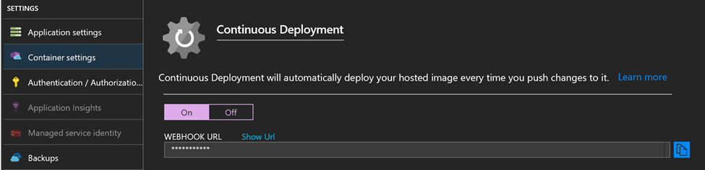
Continuous Deployment
Image:tag combination must remain the same.
Registry hits SCM endpoint of /docker/hook via a webhook.
Triggers App Service to pull a new image.
App Service performs an overlapped recycle.

Slide 12
Multi-Containers
Support Docker Compose and Kubernetes
Configuration via YAML file
One container is the web container
If your YAML file has only one container in it, we'll use that container as the web container.
If you have set the WEBSITES_WEB_CONTAINER_NAME app setting, we will use that as the web container.
We will pick the first container in your YAML file that exposes either port 80 or port 8080.
If we make it this far and we haven't picked the web container, we'll use the first container in the list of containers in your YAML file.
All containers must start for successful deployment
All images must use the same Docker registry

Slide 13
Docker Compose
version: '3.3'
services:
db:
image: mysql:5.7
volumes:
- db_data:/var/lib/mysql
restart: always
environment:
MYSQL_ROOT_PASSWORD: somewordpress
MYSQL_DATABASE: wordpress
MYSQL_USER: wordpress
MYSQL_PASSWORD: wordpress
wordpress:
image: wordpress:latest
ports:
- "8000:80"
restart: always
environment:
WORDPRESS_DB_HOST: db:3306
WORDPRESS_DB_USER: wordpress
WORDPRESS_DB_PASSWORD: wordpress
volumes:
db_data:
Notes:
Mention here that the indentation is important.
Must indent at least one space.
Indentations must be consistent.
This is a compose file. Defines “services”, each one consisting of a Docker image.
Also point out that the “wordpress” service exposes port 80, so it’s the web container.
We don’t support all options in a compose file. Documentation shows what is and isn’t supported. You might want to show that in a browser.

Slide 14
Kubernetes
Sometimes called Kube or K8s.
Designed to orchestrate multiple containers, but requires a container runtime.
In App Service, Docker is the container runtime.
Docker has an orchestration feature called Docker Swarm. It’s not supported in App Service.
In App Service, we support the creation of Kubernetes pods.
A pod is a group of one or more containers that share storage and a network.
Pods are defined by a Kubernetes config file. (We require YAML format.)

Slide 15
Kubernetes Config File
apiVersion: v1
kind: Pod
metadata:
name: wordpress
spec:
containers:
- image: redis:3-alpine
name: redis
- image: microsoft/multicontainerwordpress
name: wordpress
ports:
- containerPort: 80
volumeMounts:
- name: appservice-storage
mountPath: /var/www/html
subPath: /site/wwwroot
volumes:
- name: appservice-storage
hostConfig:
path: ${WEBAPP_STORAGE_HOME}
Notes:
Point out that ${WEBAPP_STORAGE_HOME} can be used to refer to shared storage enabled with App Service Storage.

Slide 16
Kudu in Linux
Runs in a separate container.
Debug Console offers Bash and SSH
Bash is in Kudu container
SSH is app container
Notes:
Recommend that you demo Kudu here.

Slide 17
SSH and Linux
Blessed images have SSH enabled.
Custom images require some “special sauce.”
SSH available in browser via WebSSH.
SSH available in other clients via TCP tunnel.
Notes:
Do an instructor walkthrough here using the steps outline in https://aka.ms/ThingsYouShouldKnow/AppServiceSSH.

